Slide 1
Big Data
Hands on Spark

Slide 2
A definition for Big Data
"Big data exceeds the reach of commonly used hardware environments and software tools to capture, manage, and process it with in a tolerable elapsed time for its user population." - Teradata Magazine article, 2011
"Big data refers to data sets whose size is beyond the ability of typical database software tools to capture, store, manage and analyze." - The McKinsey Global Institute, 2012
"Big data is data sets that are so voluminous and complex that traditional data processing application softwares are inadequate to deal with them." - Wikipedia
Notes:
Oggi: per Big Data intendiamo quelle architetture e quegli strumenti che permettono di gestire ed elaborare i dati in un ambiente distribuito.
Il fatto che tu «non sia in grado di gestirli» non significa che siano big data

Slide 3
When does data become "Big"?
BIG
DATA
IOPS
(Input/Output Operations Per Second)
Normal
processing
capability
Data volume

Slide 4
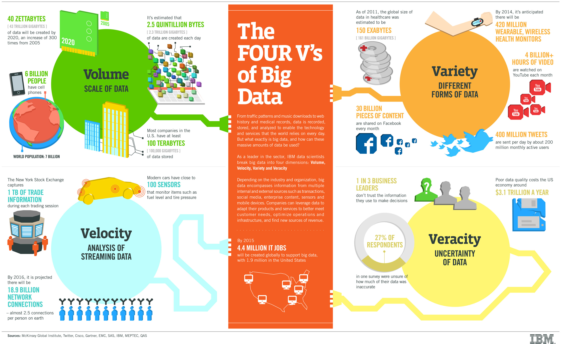
The four "V's" of Big Data
http://www.ibmbigdatahub.com/sites/default/files/infographic_file/4-Vs-of-big-data.jpg
Notes:
Dopo questo mare di infografiche, ne ricaviamo che ci sono 4 aspetti che definiscono il concetto di BD.

Slide 5
Scale up vs scale out
There was a false notion that spread through the IT community that bigger is always better
Notes:
Questo (slide prec.) per quanto riguarda i dischi. Per quanto riguarda le risorse, il problema che si pone è simile.
https://www.brianjgraf.com/2013/05/17/scalability-scale-up-scale-out-care/
https://turbonomic.com/blog/on-technology/cloud-scalability-scale-vs-scale/
http://www.microlandusa.com/microland/marketing/Crucial-Scale-Up-or-Scale-Out.html
https://blog.codinghorror.com/scaling-up-vs-scaling-out-hidden-costs/

Slide 6

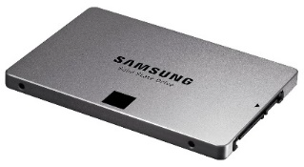
How do we process Big Data?
Main issues
Where do we store the data?
How do we process it?
Big Data greatly exceeds the size of the typical drives
Even if a big drive existed, it would be too slow (at least for now)
Year: 1990
Size: 1.3 GB
Speed: 4,4 MB/s
Year: 2014
Size: 1 TB
Speed: 100 MB/s
Year: 2015
Size: 1 TB
Speed: 600 MB/s
5 minutes
3 hours
30 minutes

Slide 7
Scale up
Adding more processors and RAM, buying expensive and robust server
Pros
Less power consumption than running multiple servers
Cooling costs are less than scaling horizontally
Generally less challenging to implement
Less licensing costs
Less networking equipment
Cons
PRICE
Greater risk of hardware failure causing bigger outages
Generally severe vendor lock-in
Not long-term: limited upgradeability in the future

Slide 8
Scale out
Adding more servers with less processors and RAM
Pros
Much cheaper than scaling vertically
New technologies simplify fault-tolerance and systems monitoring
Easy to upgrade
Usually cheaper
Can literally scale infinitely
Cons
More licensing fees
Bigger footprint in the Data Center
Higher utility cost (electricity and cooling)
Possible need for more networking equipment (switches/routers)
Notes:
Footprint = spazio occupato

Slide 9
Commodity hardware
You are not tied to expensive, proprietary offerings from a single vendor
You can choose standardized, commonly available hardware from a large range of vendors to build your cluster
Commodity ≠ Low-end!
Cheap components with high failure rate can be a false economy
Notes:
https://it.wikipedia.org/wiki/Commodity
Commodity è un termine inglese che indica un bene per cui c'è domanda ma che è offerto senza differenze qualitative sul mercato ed è fungibile, cioè il prodotto è lo stesso indipendentemente da chi lo produce, come per esempio il petrolio o i metalli.
La commoditization accade quando beni o servizi di un determinato mercato perdono la loro differenziazione. Spesso questo avviene quando c'è una diffusione della conoscenza per offrire efficientemente quel determinato prodotto o servizio. Alcuni esempi di commoditization possono essere medicine non più protette da brevetto o microprocessori la cui tecnologia è diventata pubblica e la cui produzione esclusiva non è più garantita da contratti.

Slide 10
The answer: cluster computing
100 hard disks? 2 mins to read 1TB
Notes:
Quindi cmq, un insieme di dischi ci vuole

Slide 11
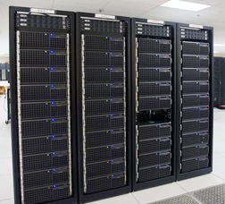
Cluster computing
Compute nodes are stored on racks
8–64 compute nodes on a rack
There can be many racks of compute nodes
The nodes on a single rack are connected by a network (typically gigabit Ethernet)
Racks are connected by another level of network (or a switch)
The bandwidth of intra-rack communication is usually much greater than that of inter-rack communication
Notes:
«Compute nodes can fail» si può anche togliere

Slide 12
Cluster Computing Architecture
A computer cluster is a group of linked computers (nodes), working together closely so that in many respects they form a single computer
Typically connected to each other through fast LAN (slower than MPI)
Every node is a system on its own, capable of independent operations
Unlimited scalability, no vendor lock-in
Number of nodes in the cluster >> Number of CPUs in a node
LAN
CPUs
CPUs
CPUs
CPUs
RAM
RAM
RAM
RAM
DISK
DISK
DISK
DISK

Slide 13
Distributed computing: an old idea
"Work"
Divide
w₁
w₂
w_{n}
"worker"
"worker"
"worker"
r₁
r₂
r_{n}
"Result"
Conquer
Notes:
L’alternativa qual è?

Slide 14
Parallelization Challenges
How do we assign work units to workers?
What if we have more work units than workers?
What if workers need to share partial results?
How do we aggregate partial results?
How do we know all the workers have finished?
What if workers die?

Slide 15
Risks?
Deadlock and starvation
Parallelization problems arise from:
Communication between workers (e.g., to exchange state)
Access to shared resources (e.g., data)
We need synchronization
Notes:
https://it.wikipedia.org/wiki/Starvation

Slide 16
But...
It is difficult to reason about parallelization
It is even more difficult to reason about concurrency
At the scale of datacenters (even across datacenters)
In the presence of failures
In terms of multiple interacting services
Not to mention debugging…
The reality can be hard
Lots of one-off solutions, custom code
Write your own dedicated library, then program with it
Burden on the programmer to explicitly manage everything

Slide 17
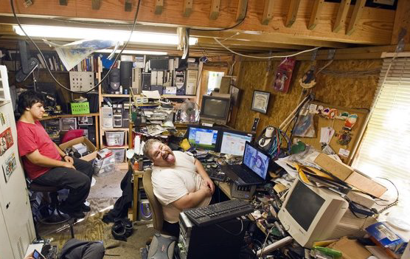
What is the solution?
Hide system-level details from the developers
No more race conditions, lock contention, etc.
No need to become hardcore techies
Separate the what from the how
Developer specifies the computation that needs to be performed
Execution framework (“runtime”) handles the actual execution
The datacenter IS the computer!

Slide 18
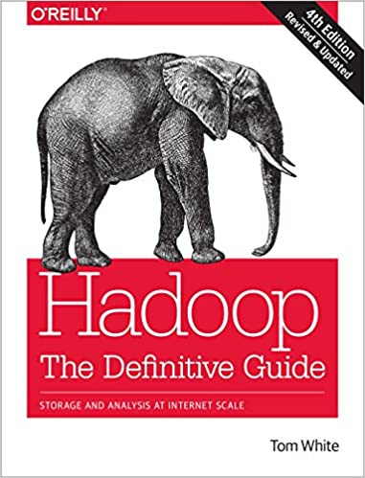
Disambiguation of MapReduce
"MapReduce is a programming model and an associated implementation for processing and generating large data sets. Users specify a map function that processes a key/value pair to generate a set of intermediate key/value pairs, and a reduce function that merges all intermediate values associated with the same intermediate key."
-- Dean J., Ghemawat S. (Google)
Hadoop MapReduce is an open-source implementation of the MapReduce programming model

Slide 19
Limitations of Map Reduce
Designed for batch processing
Not suitable for iterative algorithms or interactive data mining
Strict paradigm
Everything has to fit into Map and Reduce
Complex algorithms will take multiple jobs and passes on hard disk
New hardware capabilities are not exploited
Too much pressure on disk; RAM and multicore not adequately exploited
Too much complex
Notes:
https://www.youtube.com/watch?v=9mN3N3aoF2w&t=1506s
Removed:
Tight coupling with runtime
MapReduce job cannot run on a different engine
When is MapReduce better? https://www.quora.com/When-is-Hadoop-MapReduce-better-than-Spark
ETL jobs with large result sets
Cases where memory may be a limit
Better fault-tolerance
Removed from «programming model»: Lack of control structures and data types

Slide 20
Limitations of Map Reduce
HDFS read
HDFS write
HDFS read
HDFS write
iter. 1
iter. 2
...
Input
Map
Reduce
Input
Map
Output
Reduce
Map
Notes:
Map reduce comes from architecture of 2000: disk was cheap, RAM and network wasn't too fast, network
Also software was different; mostly object oriented, optimized for single core, no framework for distributed storage/processing, mostly SQL (now, with nosql it is natural to transition to functionalprogramming, mapreduce)
https://www.youtube.com/watch?v=9mN3N3aoF2w
Removed from interactive: ad-hoc reporting

Slide 21
Spark
It is a fast and general-purpose execution engine
In-memory data storage for very fast iterative queries
Easy interactive data analysis
Combines different processing models (machine learning, SQL, streaming, graph computation)
Provides (not only) a MapReduce-like engine..
..but it’s up to 100x faster than Hadoop MapReduce
Compatible with Hadoop’s storage APIs
Can run on top of a Hadoop cluster
Can read/write to any database and any Hadoop-supported system, including HDFS, HBase, Parquet, etc.

Slide 22
What does Spark offer?
In-memory data caching
HDD is scanned once, then data is written to/read from RAM
Lazy computations
The job is optimized before its execution
Efficient pipelining
Writing to HDD is avoided as much as possible

Slide 23
Spark pillars
Two main abstractions of Spark
RDD – Resilient Distributed Dataset
An RDD is a collection of data items
It is split into partitions
It is stored in memory on the worker nodes of the cluster
DAG – Direct Acyclic Graph
A DAG is a sequence of computations performed on data
Each node is an RDD
Each edge is a transformation of one RDD into another

Slide 24
RDD
RDDs are immutable distributed collection of objects
Resilient: automatically rebuild on failure
Distributed: the objects belonging to a given collection are split into partitions and spread across the nodes
RDDs can contain any type of Python, Java, or Scala objects
Distribution allows for scalability and locality-aware scheduling
Partitioning allows to control parallel processing
Fundamental characteristics (mostly from pure functional programming)
Immutable: once created, it can’t be modified
Lazily evaluated: optimization before execution
Cacheable: can persist in memory, spill to disk if necessary
Type inference: data types are not declared but inferred (≠ dynamic typing)

Slide 25
RDD operations
RDDs offer two types of operations: transformations and actions
Transformations construct a new RDD from a previous one
E.g.: map, flatMap, reduceByKey, filtering, etc.
https://spark.apache.org/docs/latest/programming-guide.html#transformations
Actions compute a result that is either returned to the driver program or saved to an external storage system (e.g., HDFS)
E.g.: saveAsTextFile, count, collect, etc.
https://spark.apache.org/docs/latest/programming-guide.html#actions

Slide 26
RDD operations
RDDs are lazily evaluated, i.e., they are computed when they are used in an action
Until no action is fired, the data to be processed is not even accessed
Example (in Python)
sc = new SparkContext
rddLines = sc.textFile("myFile.txt")
rddLines2 = rddLines.filter (lambda line: "some text" in line)
rddLines2.first()
There is no need to compute and store everything
In the example, Spark simply scans the file until it finds the first matching line
Transformations
Action

Slide 27
DAG
Based on the user application and on the lineage graphs, Spark computes a logical execution plan in the form of a DAG
Which is later transformed into a physical execution plan
The DAG (Directed Acyclic Graph) is a sequence of computations performed on data
Nodes are RDDs
Edges are operations on RDDs
The graph is Directed: transformations from a partition A to a partition B
The graph is Acyclic: transformations cannot return an old partition

Slide 28
Application decomposition
Application
Single instance of SparkContext that stores data processing logic and schedules series of jobs, sequentially or in parallel
Job
Complete set of transformations on RDD that finishes with action or data saving, triggered by the driver application
Stage
Set of transformations that can be pipelined and executed by a single independent worker
Task
Basic unit of scheduling: executes the stage on a single data partition

Slide 29
DAG example
Word count in Scala
textFile = sc.textFile("hdfs://...")
textFile

Slide 30
DAG example
Word count in Scala
textFile = sc.textFile("hdfs://...")
counts = textFile .flatMap(line => line.split(" "))
textFile
flatMap

Slide 31
DAG example
Word count in Scala
textFile = sc.textFile("hdfs://...")
counts = textFile .flatMap(line => line.split(" ")) .map(lambda word: (word, 1))
textFile
flatMap
map

Slide 32
DAG example
Word count in Scala
textFile = sc.textFile("hdfs://...")
counts = textFile
.flatMap(line => line.split(" ")) .map(lambda word: (word, 1)) .reduceByKey(lambda a, b: a + b)
reduce ByKey
textFile
flatMap
map

Slide 33
DAG example
Word count in Scala
textFile = sc.textFile("hdfs://...")
counts = textFile
.flatMap(line => line.split(" ")) .map(lambda word: (word, 1)) .reduceByKey(lambda a, b: a + b)
counts.saveAsTextFile("hdfs://...")
reduce ByKey
saveAs TextFile
textFile
flatMap
map

Slide 34
Conceptual representation
1
output = counts.collect()
3
textFile = sc.textFile("hdfs://...")
RDD
Value
RDD
Action
RDD
RDD
Action
Value
Transformations
4
counts.saveAsTextFile("hdfs://...")
counts = text_file
.flatMap(lambda line: line.split(" ")) \
.map(lambda word: (word, 1)) \
.reduceByKey(lambda a, b: a + b)
2

Slide 35
Spark architecture
Spark uses a master/slave architecture with one central coordinator (driver) and many distributed workers (executors)
The driver and each executor are independent Java processes
Together they form a Spark application
The architecture is independent of the cluster manager that Spark runs on
Executor
tasks and data
Task
Task
Driver
resources request
Cluster Manager
resources
assignment
data
shuffling
SparkContext
Executor
tasks and data
Task
Task
Notes:
Driver can be run from the client (spark-shell) or from the AMP (for production)
https://spark.apache.org/docs/latest/running-on-yarn.html
"In cluster mode, the Spark driver runs inside an application master process which is managed by YARN on the cluster, and the client can go away after initiating the application. In client mode, the driver runs in the client process, and the application master is only used for requesting resources from YARN"

Slide 36
Spark architecture
Executor: a process responsible for executing the received tasks
Each spark application can have (and usually has) multiple executors, and each worker node can host many executors
Typically runs for the entire duration of the application
Stores (caches) RDD data in JVM heap
Tasks are the smallest unit of work and are carried out by executors
Executor
tasks and data
Task
Task
Driver
resources request
Cluster Manager
resources
assignment
data
shuffling
SparkContext
Executor
tasks and data
Task
Task
Notes:
run the tasks and provide in-memory storage for RDDs
First, they run the tasks that make up the application and return results to the driver. Second, they provide in-memory storage for RDDs that are cached by user programs, through a service called the Block Manager that lives within each executor. Because RDDs are cached directly inside of executors, tasks can run alongside the cached data.

Slide 37
Spark architecture
Driver Program (a.k.a. Spark Driver, or simply Driver)
Each spark application can only have one driver (entry point of Spark Shell)
Converts user program into tasks
Creates the SparkContext, i.e., the object that handles communications
Computes the logical DAG of operations and converts it into a physical execution plan
Schedules tasks on executors
Has a complete view of the available executors and schedules tasks on them
Stores metadata about RDDs and their partitions
Launches a webUI
Executor
tasks and data
Task
Task
Driver
resources request
Cluster Manager
resources
assignment
data
shuffling
SparkContext
Executor
tasks and data
Task
Task
Notes:
Driver: process where the main() runs.
It is the process running the user code that creates a SparkContext, creates RDDs, and performs transformations and actions. When you launch a Spark shell, you’ve created a driver program (if you remember, the Spark shell comes preloaded with a SparkContext called sc). Once the driver terminates, the application is finished.
When the driver runs, it performs two duties: Converting a user program into tasks and Scheduling tasks on executors
Why is scheduling handled by the Driver and not demanded to the Resource Manager:
data is iteratively queried in Spark; the driver knows where the data is cached, not the RM
in MR, containers are destroyed when a task is done; in Spark, an Executor stays alive. Thus, there's no need to continuously allocate containers

Slide 38

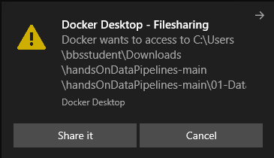
In action!
Enter the folder `03-BigData`
Double click on `run.bat`
Open the browser
Copy and paste the link 127.0.0.1:8080
Enter the notebook `04-BigData`
2

